Slide 1
Analyzing Ethernet LAN Switching
Liu Cui

Slide 2
Overview of Switching Logic
The role of a LAN switch is to forward Ethernet frames to the correct destination (MAC) address.
To achieve that goal, switches use logic—logic based on the source and destination MAC address in each frame’s Ethernet header.

Slide 3
Overview of Switching Logic
To accomplish this primary mission, switches perform three actions:
Deciding when to forward a frame or when to filter (not forward) a frame, based on the destination MAC address
Preparing to forward frames by learning MAC addresses by examining the source MAC address of each frame received by the switch
Preparing to forward only one copy of the frame to the destination by creating a (Layer 2) loop-free environment with other switches by using Spanning Tree Protocol (STP)

Slide 4
Overview of Switching Logic
Three Scenarios
Forwarding known Unicast Frames
Learning MAC addresses
Flooding Unknown Unicast and Broadcast Frames
Avoiding Loops Using Spanning Tree Protocol

Slide 5
LAN Switching Summary
Step 1: Switches forward frames based on the destination MAC address
A: If the desitnation MAC address is a broadcast, multicast, or unknown destination unicast (a unicast not listed in the MAC table), the switch floods the frame
B: If the destination MAC address is a known unicast address (a unicast address found in the MAC table):
i: table is different from the interface in which the frame was received, the switch forwards the frame out the outgoing interface.
ii: if the outgoing interface is the same as the interface in which the frame was received, the switch filters the frame, meaning that the switch simply ignores the frame and does not forward it.

Slide 6
LAN Switching Summary
Step 2: Switches use the following logic to learn MAC address table entries:
A. For each received frame, examine the source MAC address and note the interface from which the frame was received.
B. If it is not already in the table, add the MAC address and interface it was learned on.
Step 3: Switches use STP to prevent loops by causing some interfaces to block, meaning that they do not send or receive frames.

Slide 7
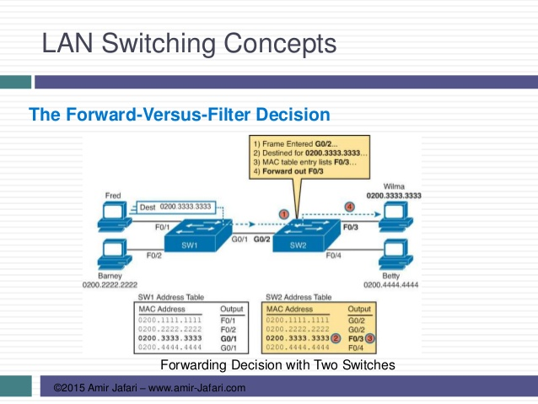
Example: Forwarding known Unicast Frames

Slide 8
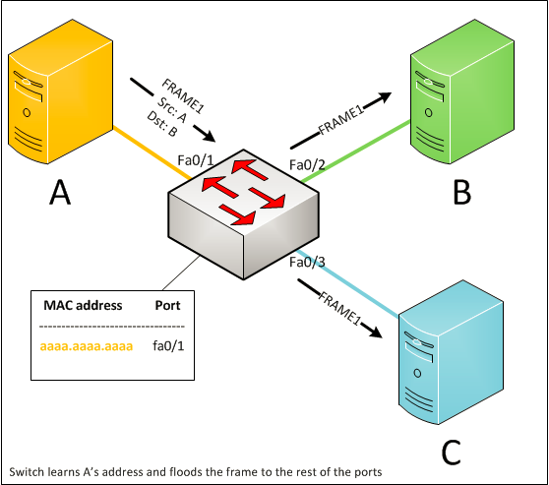
Example: Flooding Unknown Unicast and Broadcast Frames
Switches forward the frame out all interfaces, except the incoming interface using a process called flooding.

Slide 9
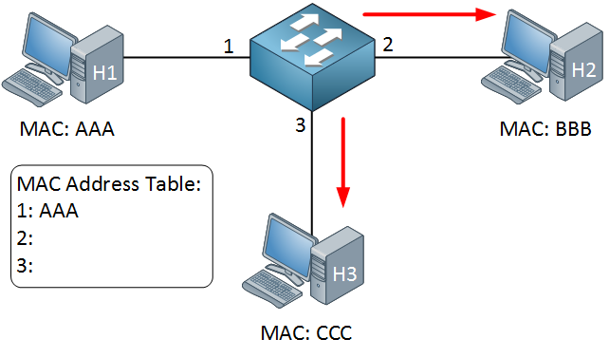
Learning MAC addresses

Slide 10
Avoiding Loops Using Spanning Tree Protocol
https://www.youtube.com/watch?v=l03o_Ns4rKo

Slide 11
Verifying and Analyzing Ethernet Switching
A Cisco Catalyst switch comes from the factory ready to switch frames. All you have to do is connect the power cable, plug in the Ethernet cables, and the switch starts switching incoming frames. Connect multiple switches together, and they are ready to forward frames between the switches as well.
Cisco Catalyst switches come ready to get busy switching frames because of settings like these”
The interfaces are enabled by default, ready to start working once a cable is connected.
All interfaces are assigned to VLAN1.
10/100 and 10/100/1000 interfaces use autonegotiation by default.
The MAC learning, forwarding, flooding logic all works by default.
STP is enabled by default.

Slide 12
Demonstrating MAC Learning
Too see a switches MAC address table, use the show mac address-table command.
Too see all the dynamically learned MAC addresses only, instead use the show mac address-table dynamic command.

Slide 13
Switch Interfaces
Once you do the installation and connect to the Console, you can easily check the status of those interfaces with the show interfaces status command.
Cisco Catalyst switches name their ports based on the fastest specification suppored. Fa for Fast Ethernet and Gi for Gigabit Ethernet.
The status column of course tells use the status or state of the port, such as connected and notconnect

Slide 14
Finding Entries in the MAC Address Table
Cisco IOS supplies several options to make it easier to find individual entries.
If you know the MAC address, you can serch for it, just type in the MAC address at the end of the command with address keyword. For example: show mac address-table dynamic address 0200.1111.1111
If you don’t know the MAC address, but the switch ports connect to other switches and which connect to end-point devices, use command such as: show mac address-table dynamic interface fastEthernet 0/1
If you want to find the MAC address table entries for one VLAN, use command such as: show mac address-table dynamic vlan1

Slide 15
Managing the MAC Address Table
Switches do learn MAC addresses, but those MAC addresses do not remain in the table indefinitely.
The switch will remove the entries due to age, due to the table filling, and you can remove entries using a command.
First, for aging out MAC table entires, switches remove entries that have not been used for a defined number of seconds (300 seconds by default).
Switches look at every incoming frame, every source MAC address.
If it is a new MAC address, the switch adds the correct entry to the table.
If the entry already exists, the switch resets the inactivity timer back to 0 for that entry.
Each entry’s timer counts upward over time to measure how long the entry has been in the table.
To show the aging time, use command: show mac address-table aging-time

Slide 16
Managing the MAC Address Table
Each switch also removes the oldest table entries, even if they are younger than the aging time setting, if the table fills.
When a switch tries to add a new table entry, and finds the table full, the switch times out (removes) the oldest table entry to make space.
You can remove the dynamic entries from the MAC address table with the clear mac address-table dynamic command.

Slide 17
MAC Address Tables with Multiple Switches
https://www.youtube.com/watch?v=rCDR2ld33FE

